Slide 1
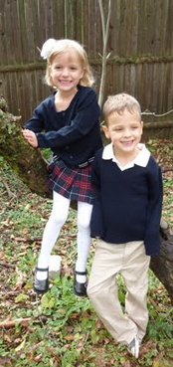
Uniform Policy Pictures taken from the French Toast Website

Slide 2
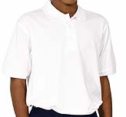
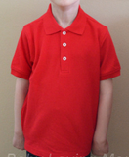
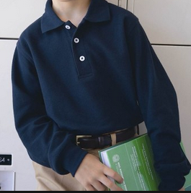
Shirts
All shirts must have a collar
All buttons except the top button must be fastened
A front shirt pocket is acceptable
Tee-shirts and turtlenecks are not allowed
No prints, patterns, striping or logos (other than the GWA logo are allowed).
Layering of shirts is not allowed
Undershirts of GWA colors may be worn-
however they many not be visible except at the collar area and must be tucked in.

Slide 3
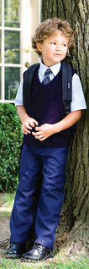
Sweaters
Sweaters, vests, and cardigans must be solid navy blue.
Sweater vests and long sleeve pullover sweaters are acceptable only with a collared shirt underneath.

Slide 4
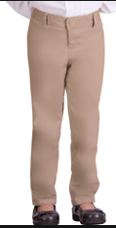
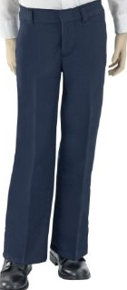
Pants
Pants must be solid navy blue or khaki colored Docker or dress style, with either a flat or pleated front (not a skinny jean look).
All pants are to be hemmed.
No Capris
No Leggings
No Patch pockets (pockets on the outside of the pants)
No Sweatpants
No Cords
No Jeans
No holes or excessive wear
No Slouched or Low-rider style
Notes:
I added “not a skinny jean look” in order to clarify what a Docker look was.

Slide 5
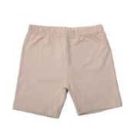
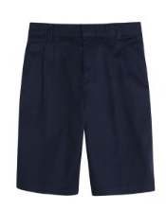
Shorts
Shorts must be solid navy blue or khaki colored Docker or dress style, with either a flat or pleated front.
All shorts are to be hemmed.
Shorts must be between two inches above the knee to two inches below the knee.
No Cargo Shorts
No Patch pockets
No holes or excessive wear
No Slouched or Low-rider style
Notes:
I added the two inches above the knee to keep in consistent with the skort/ skirt/ jumper policy. I also added the two inches below the knee so that they didn’t get so long as to be considered capri.

Slide 6
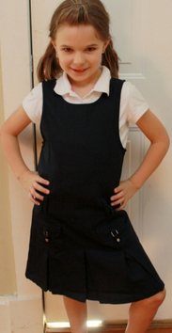
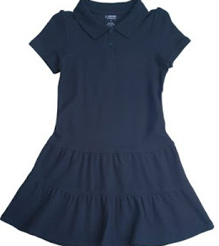
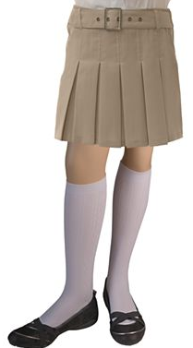
Skirts/Skorts/Jumpers
All skirts, skorts, and jumpers must be not shorter than two inches above the knee and no longer than the knee.
Skirts and skorts must be solid navy, khaki or navy/red plaid, with a pleated front in uniform style and material.
Jumpers must be solid navy, khaki or navy/red plaid, with a pleated front in uniform style and material.
'Polo' style dresses for girls are acceptable in solid navy blue only and must be of uniform style.
Plaids must match the pattern in the French Toast School Uniform Catalog. Our school plaid is navy/red.

Slide 7
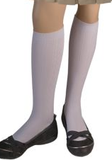
Socks & Tights
Socks must be solid white, navy blue, or tan/khaki.
Black socks may be worn if they are not visible above the shoeline.
Tights may be solid white or navy blue only
No logos may be visible above the shoeline.
Notes:
I added the logo on the sock to keep it the same as the shirt policy.

Slide 8
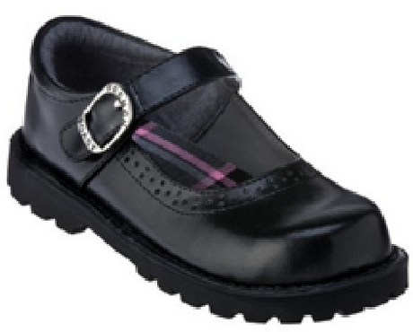
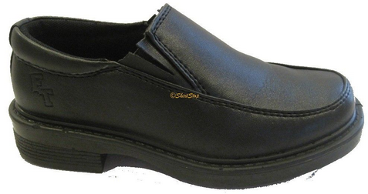
Shoes
Shoes must be a solid black or brown. All shoes should have a formal appearance.
Dress shoes, or loafer style, are recommended, however, athletic shoes of proper color, including soles, are allowed.
Shoelaces must be the same color as the shoe, and must be tied during school hours.
Slip on shoes must have a backing and a closed toe.
Boots of any type are not allowed.
Flip flops are not allowed.
'Crocs' are not allowed.

Slide 9
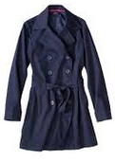
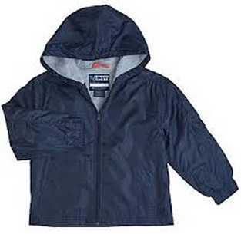
Outerwear
Jackets, coats, or windbreakers (appropriate for very cold days) must be solid navy blue or black. The lining of these may be a different color.
Outerwear may have a hood, but the hood may not be worn inside school buildings.
Sweatshirts, hoodies, and/or pullover sweatshirts are not allowed.

Slide 10
Accessories
Accessories, such as hair ribbons, bows, etc., must be school colors and should be understated.
Earrings should be small and understated.
Other jewelry is discouraged and should remain hidden.
Hair pieces are not allowed.
Students have the responsibility to avoid apparel or accessories that are so extreme that they interrupt school decorum, student concentration, or adversely affect the educational process. Extreme includes any piercing of the body with the exception of the ear. Gauging of the ear is considered extreme and not allowed.

Slide 11
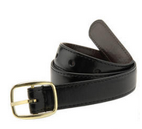
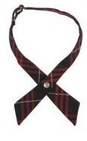
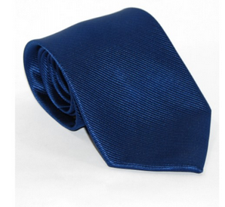
Belts & Ties
Boys & Girls: Belts must be navy blue, black, or brown only. Scarves and sashes are not allowed.
Boys: Ties may be worn with long or short sleeved white dress shirts only and must be school colors (red, white, or navy blue).

